Slide 1
Demand Analysis
Introduction, Meaning, Types, Determinants Of Demand

Slide 2
Introduction
Demand is one of the crucial requirements for the existence of any business enterprise.
A firm is interested in its own profit and /or sales, both of which depend partially upon the demand for its product.
The decisions which management makes with respect to production, advertising, cost allocation, pricing etc. call for an analysis of demand.
Demand Analysis seeks to identify and measure the forces that determine sales.

Slide 3
Meaning of Demand
Demand for a commodity implies:
a) Desire to acquire it,
b) Willingness to pay for it, and
c) Ability to pay for it.
It should be noted here that demand for any commodity or service has no meaning unless it is stated with reference to the time, its price and that of related commodities, consumer incomes and tastes.

Slide 4
Types of Demand
1. Demand for consumers’ goods and producers’ goods
2. Demand for perishable and durable goods
3. Derived demand and autonomous demand
4. Firm and Industry demand
5. Demand by total market and by market segments.

Slide 5


Slide 6
Determinants of Demand
A consumer’s demand for a commodity or service depends on several factors, the most important of which are the following:
a) Consumers’ Income - Inferior Goods & Superior Goods, Engel Curve
b) Price of the Commodity or services (own price)
c) Prices of related goods or services - substitutes and complements
d) Consumer tastes and preferences
e) Population and its distribution
f) Consumers’ expectations

Slide 7
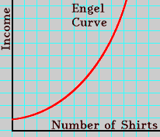
Engel Schedule & Engel Curve
Engel Schedule
Income Demand for Shirts
Rs. Units
10000 10
20000 16
30000 21
40000 25
50000 27

Slide 8
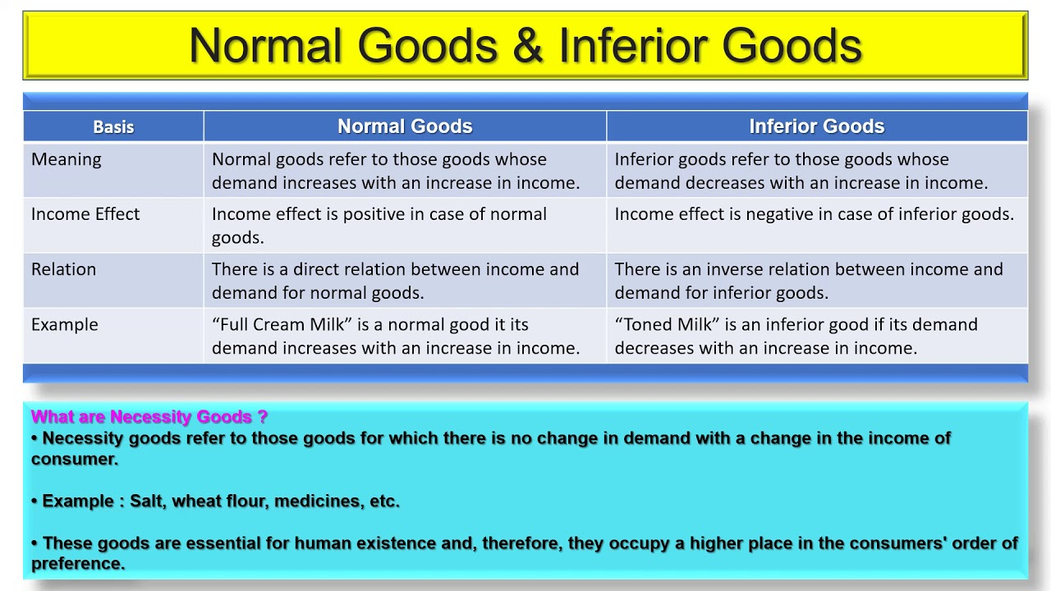

Slide 9
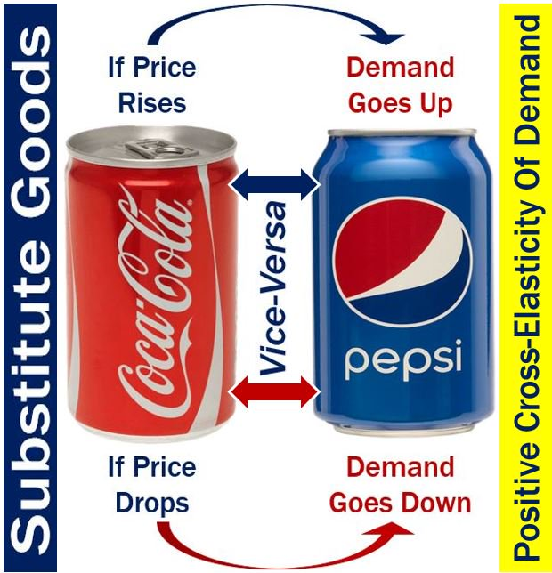
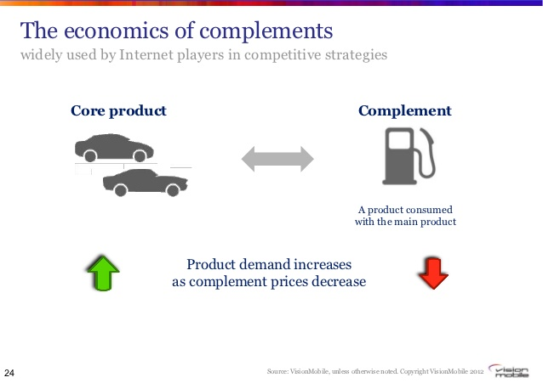
Substitutes and Complements

Slide 10
Demand Function
A demand function states the dependence relationship between the demand for a commodity or service and the factors affecting it.
D_{x} = f (I, P_{x}, P_{s}, P_{c}, T, U)
Where,
D_{x} = demand for X
I = consumers’ income
P_{x} = price of X
P_{s} = price of substitutes of X
P_{c} = price of complements of X
T = measure of consumers’ tastes and preferences
U = “other” determinants of demand for X

Slide 11
Price and Demand
The relation of Price to sales has been a major interest of Economists and Business Executives.
Law of Demand
The relation of price to sales is known in economics as the ‘Law of Demand”. The Law of Demand states that “higher the price, lower the demand, and vice versa, other things remaining the same”.

Slide 12
Demand Schedule, Demand Curve and Demand Function
Demand Schedule
The price-quantity relation, if shown arithmetically in the form of table showing prices and corresponding quantities, its known as “Demand Schedule”.
Demand Curve
The ‘Law of Demand’ or the price-Quantity relationship, if portrayed graphically, in the form of a chart, it is called as the “Demand Curve”.
Demand Function
The Price-Quantity relation expressed algebrically in the form of an equation, its known as “Demand Function”.
Q = f(P), which means quantity demanded is a function of price.

Slide 13
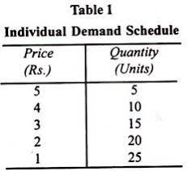
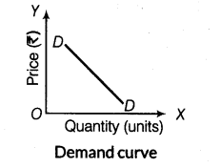
Demand Schedule and Demand Curve

Slide 14
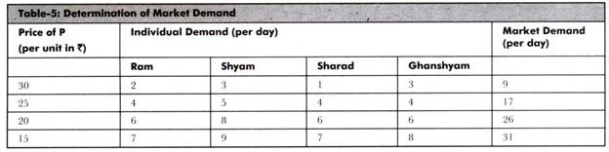

Slide 15
Chief Characteristics of Law of Demand
1. Inverse Relationship
2. Price, an independent variable, and quantity demand a dependent variable
3. Other things remain the same
4. Reasons underlying the Law of Demand
i. Income Effect
ii. Substitution Effect

Slide 16
Exceptions to Law of Demand
1. Giffen’s Goods
2. non-Giffen’s Goods
a). When the good in question is a luxury item
b). When the good whose demand is being studied goes out of fashion
c). When price expectations are of the kind found in stock markets.

Slide 17
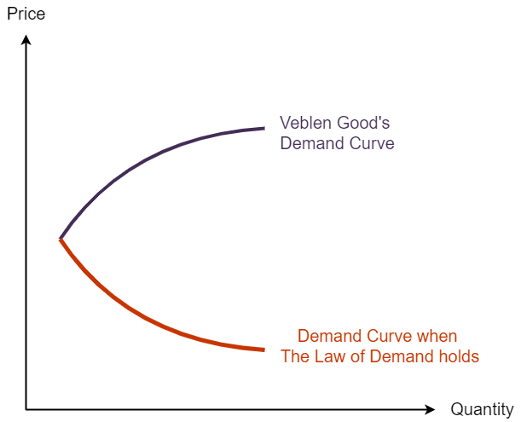

Slide 18
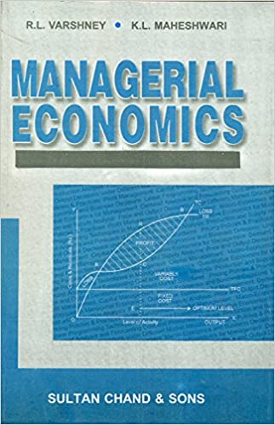
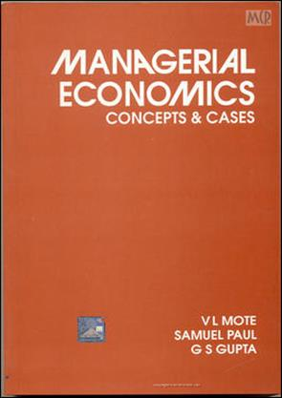
Reference

